Slide 1


Ensemble Technique
By Jiten Sahoo

Slide 2
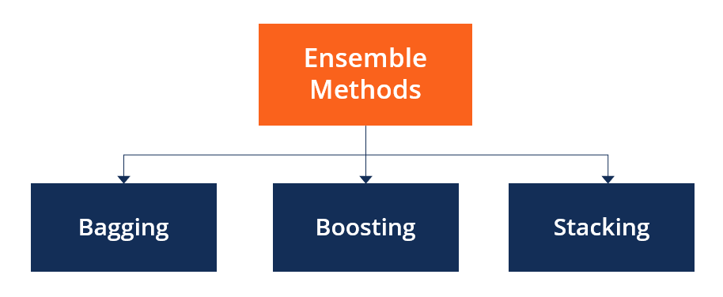
What are Ensemble Methods?
Ensemble methods are techniques that aim at improving the accuracy of results in models by combining multiple models instead of using a single model. The combined models increase the accuracy of the results significantly. This has boosted the popularity of ensemble methods in ML.

Slide 3

Categories of Ensemble Methods
Ensemble methods fall into two broad categories,
1.sequential ensemble techniques
2.parallel ensemble techniques.

Slide 4
Sequential ensemble techniques generate base learners in a sequence, e.g., Adaptive Boosting (AdaBoost). The sequential generation of base learners promotes the dependence between the base learners. The performance of the model is then improved by assigning higher weights to previously misrepresented learners.

Slide 5
In parallel ensemble techniques, base learners are generated in a parallel format, e.g., random forest. Parallel methods utilize the parallel generation of base learners to encourage independence between the base learners. The independence of base learners significantly reduces the error due to the application of averages.
Main Types of Ensemble Methods
Bagging
Boosting
Stacking

Slide 6
Bagging
Bagging, the short form for bootstrap aggregating, is mainly applied in classification and regression. It increases the accuracy of models through decision trees, which reduces variance to a large extent. The reduction of variance increases accuracy, eliminating overfitting, which is a challenge to many predictive models.
Bagging is classified into two parts, i.e., bootstrapping and aggregation. Bootstrapping is a sampling technique where samples are derived from the whole population (set) using the replacement procedure. The sampling with replacement method helps make the selection procedure randomized. The base learning algorithm is run on the samples to complete the procedure.

Slide 7
Aggregation in bagging is done to incorporate all possible outcomes of the prediction and randomize the outcome. Without aggregation, predictions will not be accurate because all outcomes are not put into consideration. Therefore, the aggregation is based on the probability bootstrapping procedures or on the basis of all outcomes of the predictive models.
Bagging is advantageous since weak base learners are combined to form a single strong learner that is more stable than single learners. It also eliminates any variance, thereby reducing the overfitting of models. One limitation of bagging is that it is computationally expensive. Thus, it can lead to more bias in models when the proper procedure of bagging is ignored.

Slide 8
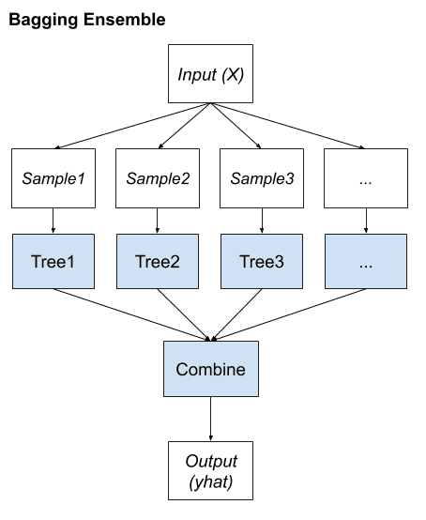

Slide 9
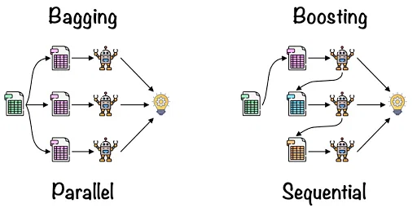

Slide 10
Boosting
Boosting is an ensemble technique that learns from previous predictor mistakes to make better predictions in the future. The technique combines several weak base learners to form one strong learner, thus significantly improving the predictability of models. Boosting works by arranging weak learners in a sequence, such that weak learners learn from the next learner in the sequence to create better predictive models.
Boosting takes many forms, including gradient boosting, Adaptive Boosting (AdaBoost), and XGBoost (Extreme Gradient Boosting). AdaBoost uses weak learners in the form of decision trees, which mostly include one split that is popularly known as decision stumps. AdaBoost’s main decision stump comprises observations carrying similar weights.
Gradient boosting adds predictors sequentially to the ensemble, where preceding predictors correct their successors, thereby increasing the model’s accuracy. New predictors are fit to counter the effects of errors in the previous predictors. The gradient of descent helps the gradient booster identify problems in learners’ predictions and counter them accordingly.
XGBoost makes use of decision trees with boosted gradient, providing improved speed and performance. It relies heavily on the computational speed and the performance of the target model. Model training should follow a sequence, thus making the implementation of gradient boosted machines slow.

Slide 11
Bagging algorithms:
01
Bagging meta-estimator
Random forest
Boosting algorithms:
02
AdaBoost
GBM
XGBM
Light GBM
CatBoost

Slide 12

Stacking
Stacking is one of the most popular ensemble machine learning techniques used to predict multiple nodes to build a new model and improve model performance. Stacking enables us to train multiple models to solve similar problems, and based on their combined output, it builds a new model with improved performance.

Slide 13
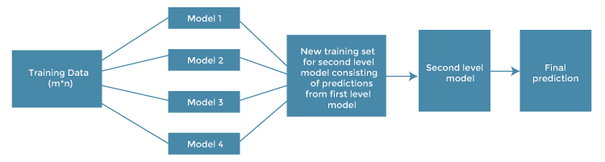
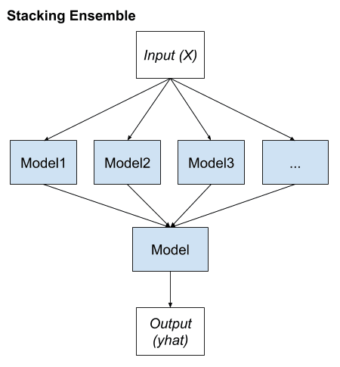

Slide 14
Steps of Stacking
Original data: This data is divided into n-folds and is also considered test data or training data.
Base models: These models are also referred to as level-0 models. These models use training data and provide compiled predictions (level-0) as an output.
Level-0 Predictions: Each base model is triggered on some training data and provides different predictions, which are known as level-0 predictions.
Meta Model: The architecture of the stacking model consists of one meta-model, which helps to best combine the predictions of the base models. The meta-model is also known as the level-1 model.
Level-1 Prediction: The meta-model learns how to best combine the predictions of the base models and is trained on different predictions made by individual base models, i.e., data not used to train the base models are fed to the meta-model, predictions are made, and these predictions, along with the expected outputs, provide the input and output pairs of the training dataset used to fit the meta-model.

Slide 15
Random Forest
The random forest algorithm is an extension of the bagging method as it utilizes both bagging and feature randomness to create an uncorrelated forest of decision trees. Feature randomness, also known as feature bagging generates a random subset of features, which ensures low correlation among decision trees. This is a key difference between decision trees and random forests. While decision trees consider all the possible feature splits, random forests only select a subset of those features.

Slide 16
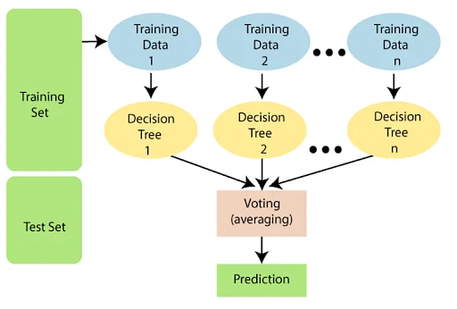

Slide 17
Why we need Random Forest
There are a lot of benefits to using Random Forest Algorithm, but one of the main advantages is that it reduces the risk of overfitting and the required training time. Additionally, it offers a high level of accuracy. Random Forest algorithm runs efficiently in large databases and produces highly accurate predictions by estimating missing data.

Slide 18
Key Benefits
Reduced risk of overfitting: Decision trees run the risk of overfitting as they tend to tightly fit all the samples within training data. However, when there’s a robust number of decision trees in a random forest, the classifier won’t overfit the model since the averaging of uncorrelated trees lowers the overall variance and prediction error.
Provides flexibility: Since random forest can handle both regression and classification tasks with a high degree of accuracy, it is a popular method among data scientists. Feature bagging also makes the random forest classifier an effective tool for estimating missing values as it maintains accuracy when a portion of the data is missing.
Easy to determine feature importance: Random forest makes it easy to evaluate variable importance, or contribution, to the model. There are a few ways to evaluate feature importance. Gini importance and mean decrease in impurity (MDI) are usually used to measure how much the model’s accuracy decreases when a given variable is excluded. However, permutation importance, also known as mean decrease accuracy (MDA), is another importance measure. MDA identifies the average decrease in accuracy by randomly permutating the feature values in oob samples.

Slide 19
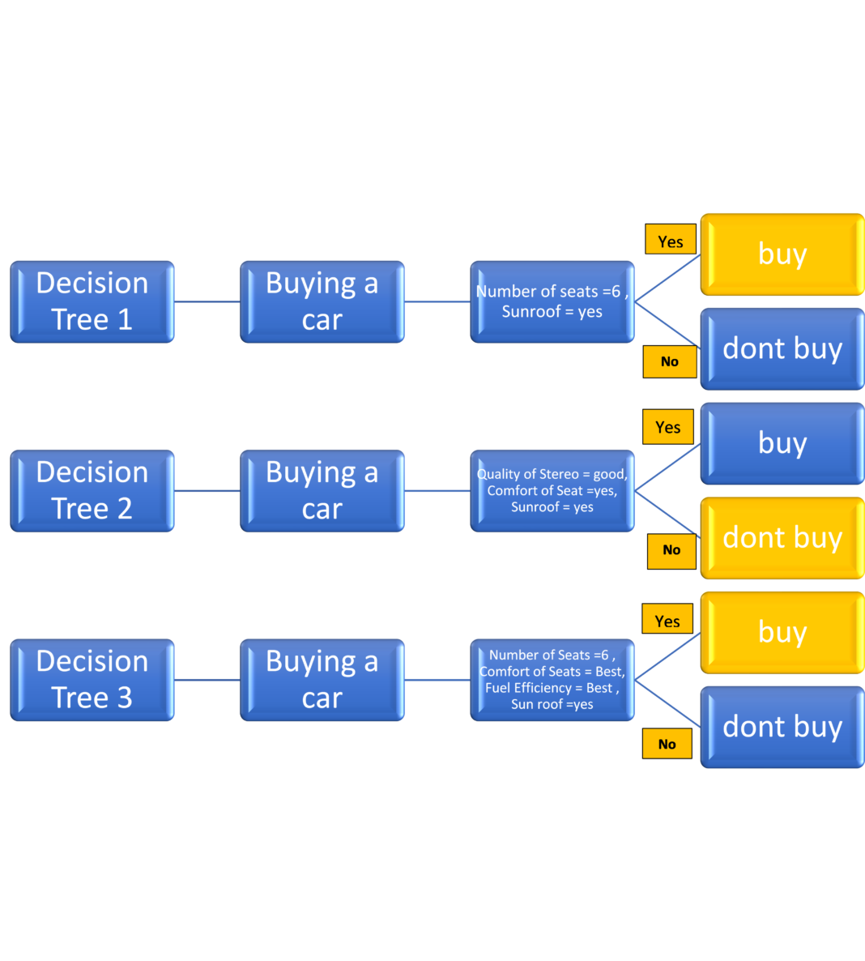

Slide 20
Important Parameters of Random Forest
n_estimators: Number of trees built by the algorithm before averaging the products.
max_features: Maximum number of features random forest uses before considering splitting a node.
mini_sample_leaf: Determines the minimum number of leaves required to split an internal node.
The following hyperparameters are used to increase the speed of the model:
n_jobs: Conveys to the engine how many processors are allowed to use. If the value is 1, it can use only one processor, but if the value is -1,, there is no limit.
random_state: Controls randomness of the sample. The model will always produce the same results if it has a definite value of random state and if it has been given the same hyperparameters and the same training data.
oob_score: OOB (Out Of the Bag) is a random forest cross-validation method. In this, one-third of the sample is not used to train the data but to evaluate its performance.

Slide 21
Random Forest VS Decision Tree
Decision trees | Random Forest
1. Decision trees normally suffer from the problem of overfitting if it’s allowed to grow without any control. | 1. Random forests are created from subsets of data, and the final output is based on average or majority ranking; hence the problem of overfitting is taken care of.
2. A single decision tree is faster in computation. | 2. It is comparatively slower.
3. When a data set with features is taken as input by a decision tree, it will formulate some rules to make predictions. | 3. Random forest randomly selects observations, builds a decision tree, and takes the average result. It doesn’t use any set of formulas.

Slide 22
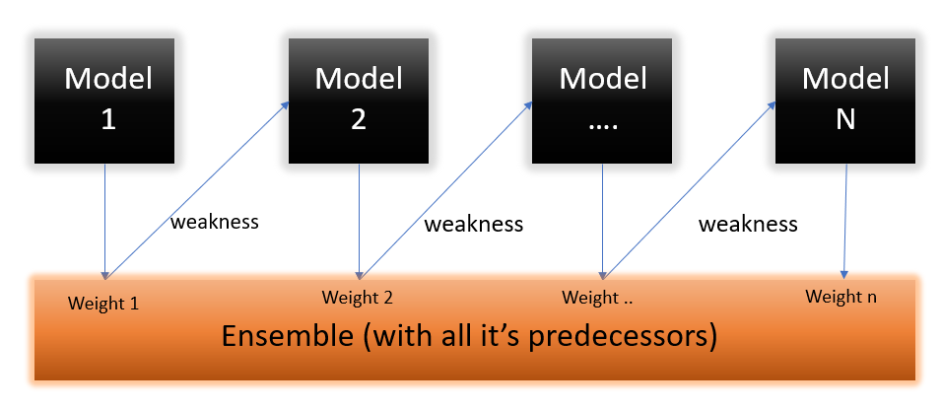
AdaBoosting
AdaBoost also called Adaptive Boosting is a technique in Machine Learning used as an Ensemble Method. The most common algorithm used with AdaBoost is decision trees with one level that means with Decision trees with only 1 split. These trees are also called Decision Stumps.

Slide 23
Features of Adaboosting
Sequential
Computational Scalability
Used to exploit dependency between models
Decision stump ( Depth is 1)
Can handle missing values & outliers
Can handle mixed predictors

Slide 24
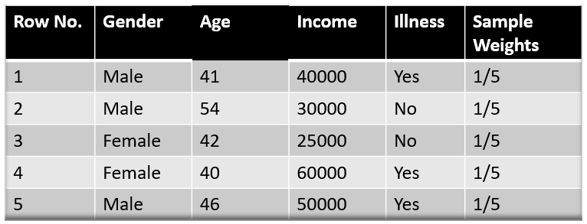
Steps to perform Adaboosting
Step 1 – The Image is shown below is the actual representation of our dataset. Since the target column is binary it is a classification problem. First of all these data points will be assigned some weights. Initially, all the weights will be equal.
The formula to calculate the sample weights is: 1/n

Slide 25
Step 2
We start by seeing how well “Gender” classifies the samples and will see how the variables (Age, Income) classifies the samples.
We’ll create a decision stump for each of the features and then calculate the Gini Index of each tree. The tree with the lowest Gini Index will be our first stump.
Here in our dataset let’s say Gender has the lowest gini index so it will be our first stump.

Slide 26

We will now calculate the “Amount of Say” or “Importance” or “Influence” for this classifier in classifying the datapoints using this formula:
The total error is nothing, but the summation of all the sample weights of misclassified data points.
Here in our dataset let’s assume there is 1 wrong output, so our total error will be 1/5, and alpha(performance of the stump) will be: 0.3

Slide 27
Step 4
Update the new weight by using following formula.
The amount of say (alpha) will be negative when the sample is correctly classified.
The amount of say (alpha) will be positive when the sample is miss-classified.

Slide 28
Normalize the New weight so that sum of weights is 1.
Then we need to make a new dataset to see if the errors decreased or not. For this we will remove the “sample weights” and “new sample weights” column and then based on the “new sample weights” we will divide our data points into buckets.
Now what the algorithm does is selects random numbers from 0-1. Since incorrectly classified records have higher sample weights, the probability to select those records is very high.
https://www.analyticsvidhya.com/blog/2021/09/adaboost-algorithm-a-complete-guide-for-beginners/

Slide 29
Advantage
Adaboost is less prone to overfitting as the input parameters are not jointly optimized. The accuracy of weak classifiers can be improved by using Adaboost.
Nowadays, Adaboost is being used to classify text and images rather than binary classification problems.
The main disadvantage of Adaboost is that it needs a quality dataset. Noisy data and outliers have to be avoided before adopting an Adaboost algorithm.

Slide 30
Gradient Boosting
The main idea behind this algorithm is to build models sequentially and these subsequent models try to reduce the errors of the previous model. To reduce the error is done by building a new model on the errors or residuals of the previous model.
When the target column is continuous, we use Gradient Boosting Regressor whereas when it is a classification problem, we use Gradient Boosting Classifier. The only difference between the two is the “Loss function”. The objective here is to minimize this loss function by adding weak learners using gradient descent. Since it is based on loss function hence for regression problems, we’ll have different loss functions like Mean squared error (MSE) and for classification, we will have different for e.g log-likelihood.

Slide 31
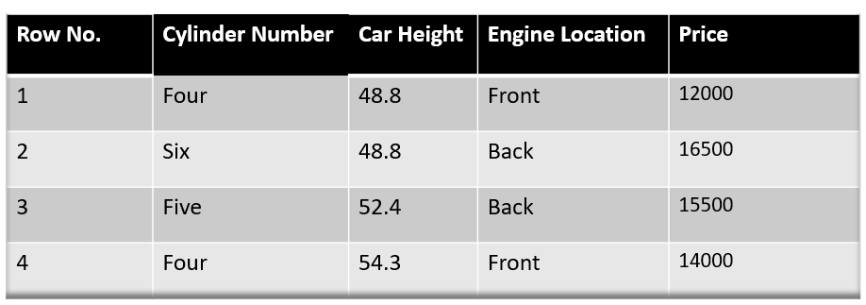
Steps to Perform Gradient Boosting Regressor
Lets take a dataset
The first step in gradient boosting is to build a base model to predict the observations in the training dataset. For simplicity we take an average of the target column and assume that to be the predicted value as shown below:

Slide 32


Step 1
The model should be initialized with a function F0(x). F0(x) should be a function which minimizes the loss function or MSE (mean squared error), in this case :
Taking the first differential of the above equation with respect to γ, it is seen that the function minimizes at the mean i=1nyin. So, the boosting model could be initiated with:

Slide 33
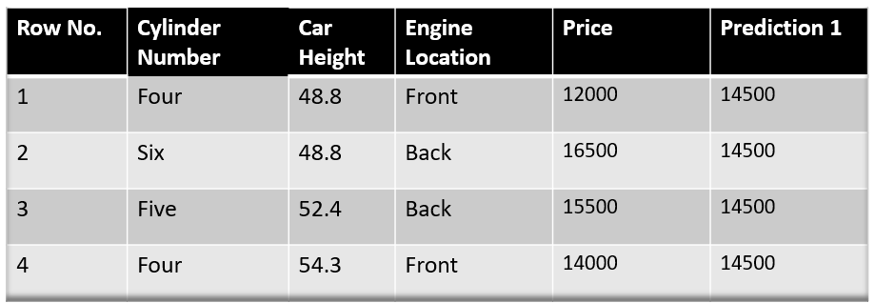
https://www.analyticsvidhya.com/blog/2021/09/gradient-boosting-algorithm-a-complete-guide-for-beginners/

Slide 34
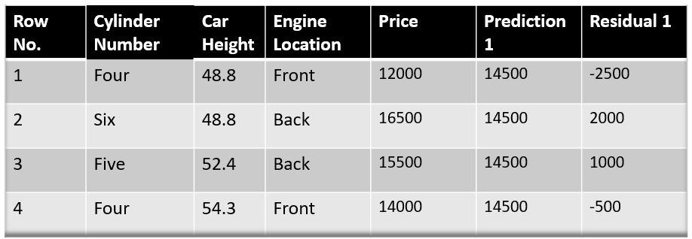
Step 3
The next step is to calculate the pseudo residuals which are (observed value – predicted value)

Slide 35
Step 3
Build a decision tree by considering residual as target variable.
In Gardient boosting max_depth is limited between 8 to 32.
Get the output(Residual) by predicting the data from decision tree .
Use Learning rate to get new output.
Gradient Boosting has the learning rate 0 to 1.

Slide 36
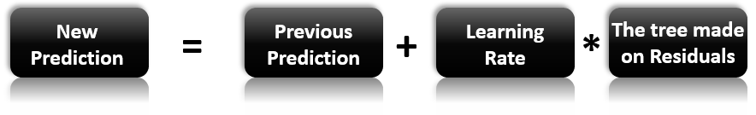
Step 4
Update the prediction by the following formula.
Repeat from the step 2 by calculating residuals again.

Slide 37
In case of Classification, we have to change only one thing which is finding out the likelihood of target.
L= log(Total no of yes / Total no of No)
Then we have to perform the same step by calculating the residual like Regression.

Slide 38
XGboost
XGBoost stands for eXtreme Gradient Boosting and it’s an open-source implementation of the gradient boosted trees algorithm. It has been one of the most popular machine learning techniques in Kaggle competitions, due to its prediction power and ease of use. It is a supervised learning algorithm that can be used for regression or classification tasks.
XGBoost has performed quite well for structured, tabular data. If you are dealing with non-structured data such as images, neural networks are usually a better option.

Slide 39
Import Xgboost
from xgboost import XGBClassifier , XGBRegressor
As it is not available default in sklearn, we have to import it manually.

Slide 40
Unique features of XGBoost
Regularization: XGBoost has an option to penalize complex models through both L1 and L2 regularization. Regularization helps in preventing overfitting
Handling sparse data: Missing values or data processing steps like one-hot encoding make data sparse. XGBoost incorporates a sparsity-aware split finding algorithm to handle different types of sparsity patterns in the data
Weighted quantile sketch: Most existing tree based algorithms can find the split points when the data points are of equal weights (using quantile sketch algorithm). However, they are not equipped to handle weighted data. XGBoost has a distributed weighted quantile sketch algorithm to effectively handle weighted data
Block structure for parallel learning: For faster computing, XGBoost can make use of multiple cores on the CPU. This is possible because of a block structure in its system design. Data is sorted and stored in in-memory units called blocks. Unlike other algorithms, this enables the data layout to be reused by subsequent iterations, instead of computing it again. This feature also serves useful for steps like split finding and column sub-sampling
Cache awareness: In XGBoost, non-continuous memory access is required to get the gradient statistics by row index. Hence, XGBoost has been designed to make optimal use of hardware. This is done by allocating internal buffers in each thread, where the gradient statistics can be stored
Out-of-core computing: This feature optimizes the available disk space and maximizes its usage when handling huge datasets that do not fit into memory

Slide 41
Step 1
Similar to Gradient boosting , it calculates the mean of output which is nothing but the condition where we will get minimum error.
In the next step we will calculate the respective residual and build a decision tree model on residuals.

Slide 42
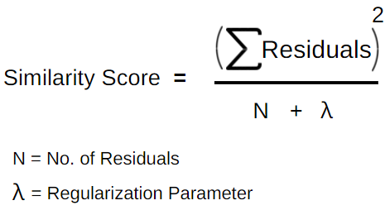
Step 2
Root node is being selected based on highest information gain.
Create a decision tree based on condition.
Calculate the similarity score of tree as well as the leaf node.
Calculate the total gain by calculating the below formula.
Gain = Similarity score of left node + right node - score before split
Calculate the gain for decision tree of other conditions as well .

Slide 43

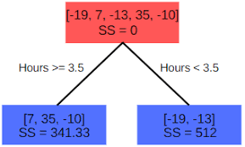




Slide 44
Calculate best Root node
Select the root node which have highest gain.
Split the tree further by calculating gain .
Auto Pruning happen in XGboost by considering a value called Gamma . If Gain is less than Gamma, then Tree will be pruned, else it will continue spliting the tree.
Then calculate the Output value of Leaf node by following formula.
Output = Sum of Residuals / (Number of Residuals + Lambda)

Slide 45
Calculate the New prediction
New value = Old Value + (Learning Rate * Output)
Continue the step till we reach the number of estimators selected.

Slide 46
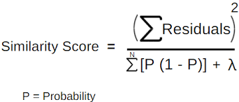
XGboost Classifier

Slide 47
Stacking vs Blending
Stacking uses out-of-fold predictions for the train set of the next layer (i.e meta-model), and Blending uses a validation set (let's say, 10-15% of the training set) to train the next layer.
https://machinelearningmastery.com/blending-ensemble-machine-learning-with-python/

Slide 48
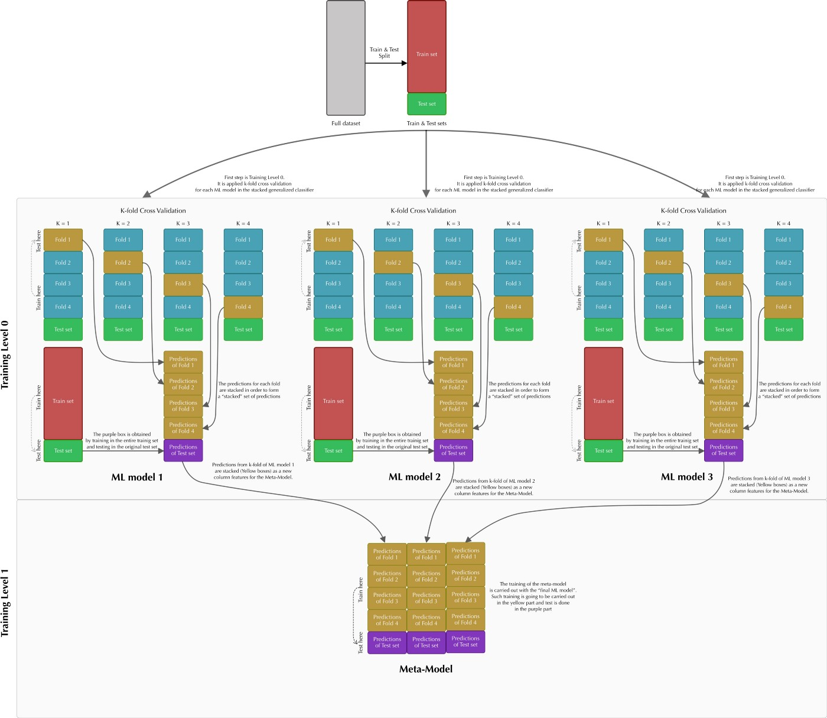

Slide 49
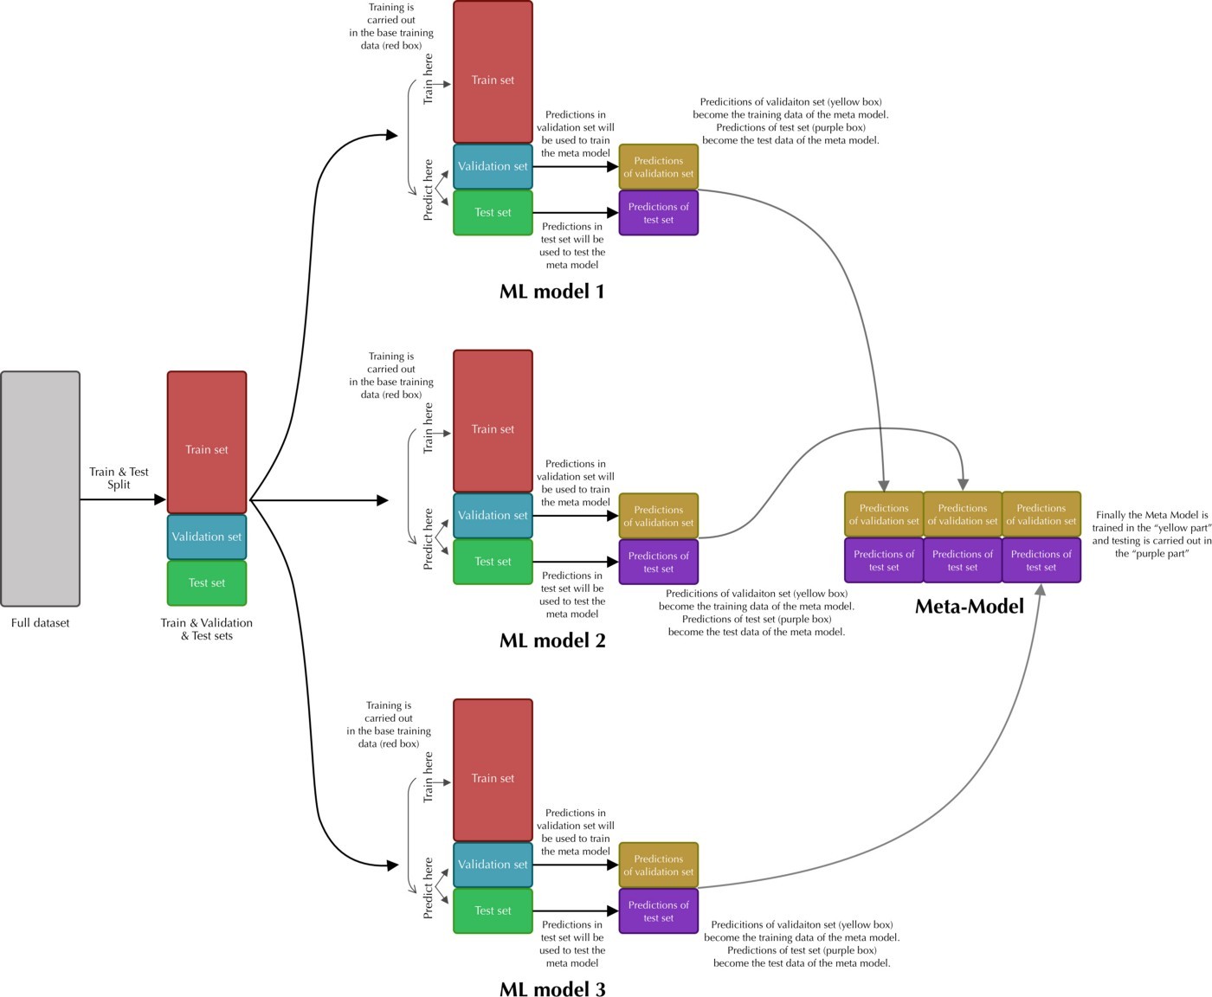

Slide 50
How to create your own classifier
A voting classifier is a machine learning estimator that trains various base models or estimators and predicts on the basis of aggregating the findings of each base estimator. The aggregating criteria can be combined decision of voting for each estimator output.
The voting criteria can be of two types:
Hard Voting: Voting is calculated on the predicted output class.
Soft Voting: Voting is calculated on the predicted probability of the output class.

Slide 51
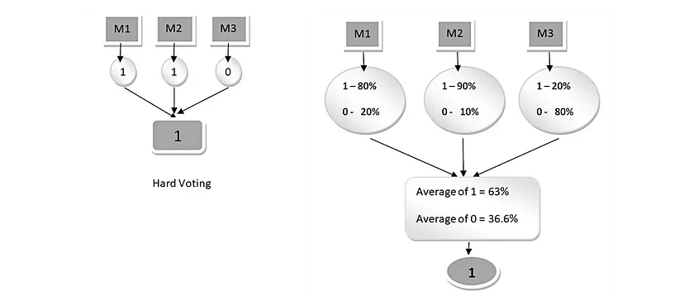
Hard Voting vs Soft Voting

Slide 52
CatBoost
CatBoost or Categorical Boosting is an open-source boosting library developed by Yandex. In addition to regression and classification, CatBoost can be used in ranking, recommendation systems, forecasting and even personal assistants.
CatBoost automatically handles categorical features. One of the most common techniques for handling categorical data is one-hot encoding, but it becomes infeasible with many features. To tackle this, features are grouped in categories by target statistics (estimate target value for each category). Target statistics can be calculated in different ways: Greedy, Hold out, Leave one out and Ordered. CatBoost uses Ordered target statistics.

Slide 53
CatBoost advantages
CatBoost implements oblivious decision trees (binary tree in which same features are used to make left and right split for each level of the tree) thereby restricting the features split per level to one, which help in decreasing prediction time.
It handles categorical features effectively by ordered target statistics.
It is easy to use with packages in R and Python.
It has effective usage with default parameters thereby reducing the time needed for parameter tuning.

Slide 54
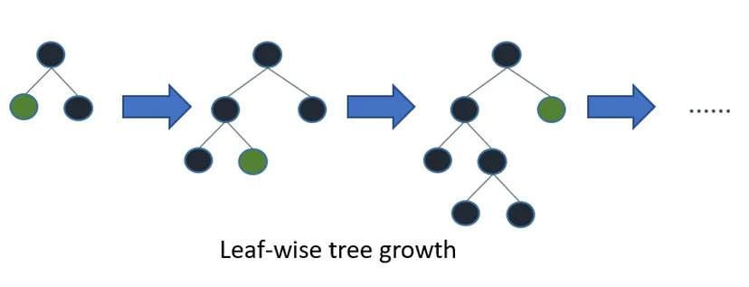
Light GBM
Light GBM is a gradient boosting framework that uses tree based learning algorithm.
Light GBM grows tree vertically while other algorithm grows trees horizontally meaning that Light GBM grows tree leaf-wise while other algorithm grows level-wise. It will choose the leaf with max delta loss to grow. When growing the same leaf, Leaf-wise algorithm can reduce more loss than a level-wise algorithm.

Slide 55
Why LIGHTGBM is more popular
The size of data is increasing day by day and it is becoming difficult for traditional data science algorithms to give faster results. Light GBM is prefixed as ‘Light’ because of its high speed. Light GBM can handle the large size of data and takes lower memory to run. Another reason of why Light GBM is popular is because it focuses on accuracy of results. LGBM also supports GPU learning and thus data scientists are widely using LGBM for data science application development.

